Slide 1


Daniel Carvalho Pedrini
05/01/2023

Slide 2

Outline
Executive Summary
Introduction
Methodology
Results
Conclusion
Appendix

Slide 3
Executive Summary
Summary of methodologies
Define and collect the data collection within different ways
Define, apply and compare Machine Learning models
Create Data Visualization to best view the data
Summary of all results
Define the best model applied
Create the Visualizations to have best decision making

Slide 4
Introduction
Project background and context
For this project, we will work with the SpaceX company to predict the Falcon 9 to check the success of the first step landing. It is important for the matter of costs.
Problems you want to find answers
What is the factors behind the failure of landing?
Will rockets land successfully?
What is the accuracy of successful landing?

Slide 5

Section 1

Slide 6
Methodology
Executive Summary
Data collection methodology:
We used two methodology for data collection: API and Web Scrapping
Perform data wrangling
We used One-hot-encoding
Perform exploratory data analysis (EDA) using visualization and SQL
Perform interactive visual analytics using Folium and Plotly Dash
Perform predictive analysis using classification models
We applied different models to compere and find the best model

Slide 7
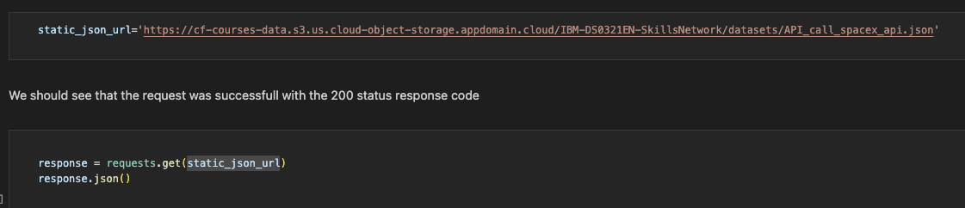
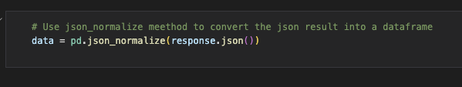
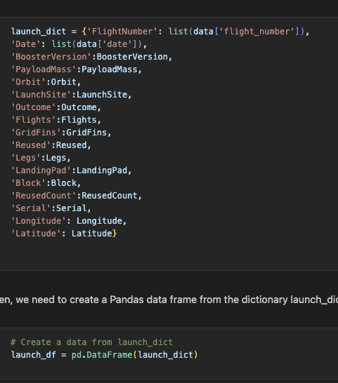
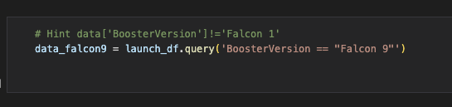
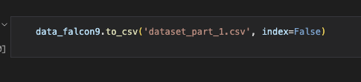
Data Collection – SpaceX API
Call the API to get the JSON
Convert JSON to DataFrame
Update Columns and Rows
Filter the data to keep Falcon 9
Save the data as .csv file
Dealing with miss values of Payload Mass
https://github.com/danielpedrini/capstone/blob/main/jupyter-labs-spacex-data-collection-api.ipynb

Slide 8
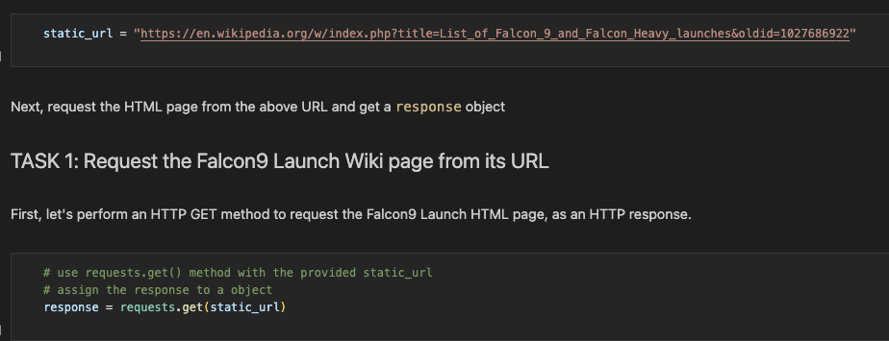
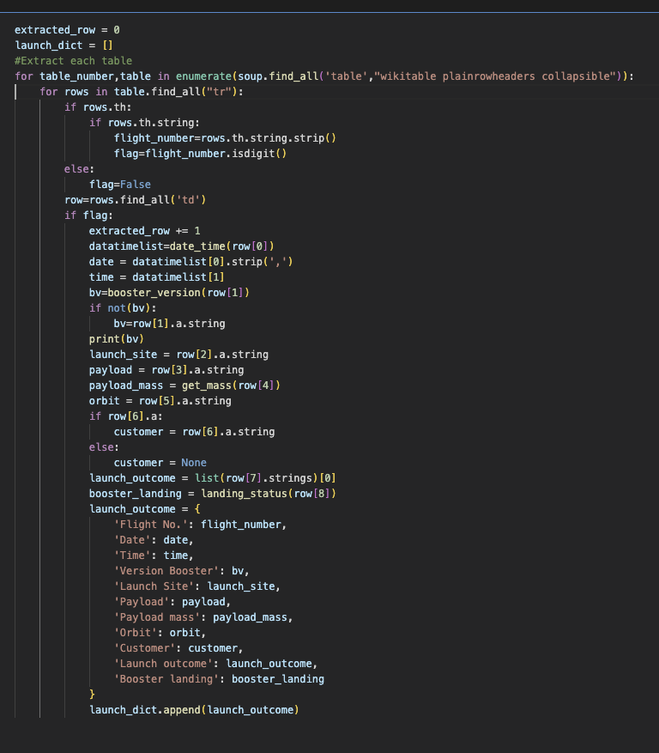
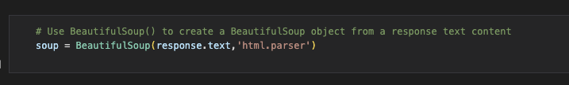
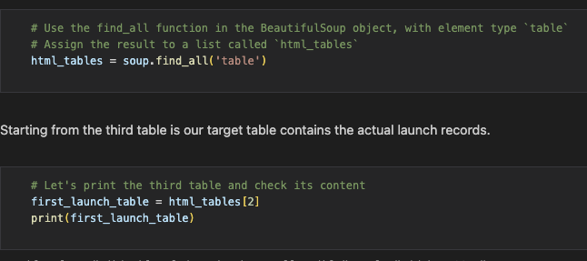
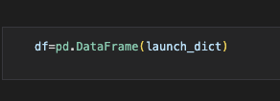
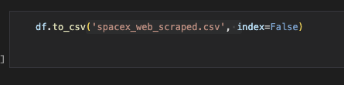
Data Collection – SpaceX API
Request the Webpage
Parser the Webpage to HTML
Retrieve the tables and find separate the second table "Flight No."
Create the DataFrame and populate with the data
Save the data as .csv file
https://github.com/danielpedrini/capstone/blob/main/jupyter-labs-webscraping.ipynb

Slide 9
Data Wrangling
Identify missing values and the percentage of missing values
Identify the data type of each columns
Check the unique values of Launch Site, Orbit and Outcomes and the frequency of each values
Create columns Class with failure outcome.
Save the file to format .csv
https://github.com/danielpedrini/capstone/blob/main/labs-jupyter-spacex-Data%20wrangling.ipynb

Slide 10
EDA with Data Visualization
Charts used in this project.
Seaborn catplot: we used this type of graphic to plot how the data behavior between different categories in each class
Seaborn barplot: We used this plot to check the mean values of class in each orbit
Seaborn lineplot: We used this plot to see the evolution of mean value of the class peer year
https://github.com/danielpedrini/capstone/blob/main/jupyter-labs-eda-dataviz.ipynb

Slide 11
EDA with SQL
Query Used to performe EDA:
select distinct(Launch_Site) from SPACEXTBL
select * from SPACEXTBL where Launch_Site like 'CCA%' limit 5
select sum(PAYLOAD_MASS__KG_) from SPACEXTBL
select avg(PAYLOAD_MASS__KG_) from SPACEXTBL where Booster_Version like 'F9 v1.1%'
select min(date) from SPACEXTBL where "Landing _Outcome" = 'Success'
select distinct(Booster_Version) from SPACEXTBL where "Landing _Outcome" = 'Success (drone ship)' and PAYLOAD_MASS__KG_ between 4000 and 6000
select count(Mission_Outcome) from SPACEXTBL where Mission_Outcome like '%Success’
select count(Mission_Outcome) from SPACEXTBL where Mission_Outcome not like '%Success'
select Booster_Version from SPACEXTBL where PAYLOAD_MASS__KG_ = (select max(PAYLOAD_MASS__KG_) from SPACEXTBL)
elect substr(Date, 4,2) as month, "Landing _Outcome", Booster_Version, launch_site, substr(Date, 7,4) from SPACEXTBL where "Landing _Outcome" = 'Failure (drone ship)' and substr(Date, 7,4) = '2015'
https://github.com/danielpedrini/capstone/blob/main/jupyter-labs-eda-sql-coursera_sqllite.ipynb
Add the GitHub URL of your completed EDA with SQL notebook, as an external reference and peer-review purpose

Slide 12
Build an Interactive Map with Folium
folium.Marker() used to create marks on map
folium.Circle() used to create a circles above ther markers
folium.Icon() used to create an icon on the map
folion.PolyLine() used to create polynomial line between points
folium.pluguins.AntPath() used to create animated line between points
markerCluster used to simplifiy the map
https://github.com/danielpedrini/capstone/blob/main/lab_jupyter_launch_site_location.ipynb

Slide 13
Build a Dashboard with Plotly Dash
Dash and html components we were used and almost everything depends on them like graphs, tables, dropbox
Ploty used to plot graphs
Pandas used to manipulate the data
Piechart and scatterchart to present the chart data
Slider to select the mass range
Dropdown to select the sites
https://github.com/danielpedrini/capstone/blob/main/dashboard.py

Slide 14
Predictive Analysis (Classification)
Separate the Features and the Target in two DataFrame
Transform the Feature to best predict the model using StandardScaler
Split the data into X_train, X_test, Y_train and Y_test
Select four models to analyze: Logistic Regression, SVM, Decision Tree and KNN
To find the best tunning, we used GridSearch to set the parameters and test all the parameters defined
Tested all the models defined with some parameters
Check the results with: Accuracy, R2_score for train and test Values
Check the Confusion Matrix for each best parameters result on the test
Compare best parameters result between the models
https://github.com/danielpedrini/capstone/blob/main/SpaceX_Machine_Learning_Prediction_Part_5.jupyterlite.ipynb

Slide 15
Results
The site with highest score was KSC LC-39A
The Payload of 0 to 5000kg was more diverse then 6000kg to 10000kg
Decision Tree was the best optimal model with the accuracy of 0.8732

Slide 16

Section 2

Slide 17
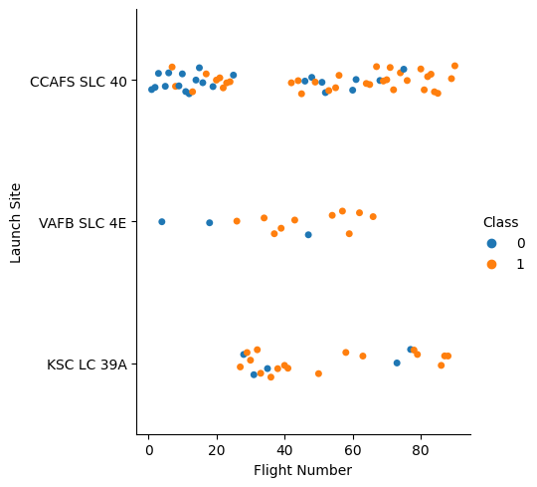
Flight Number vs. Launch Site

Slide 18
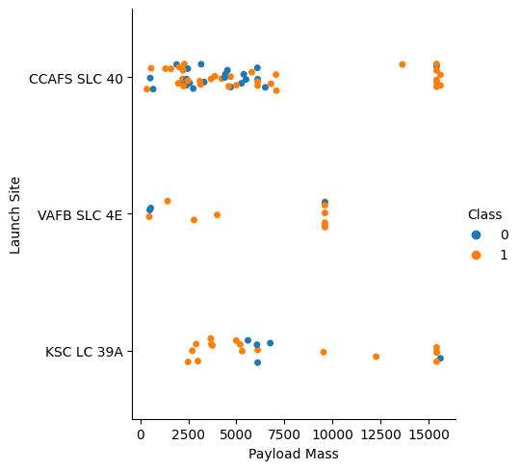
Payload vs. Launch Site

Slide 19
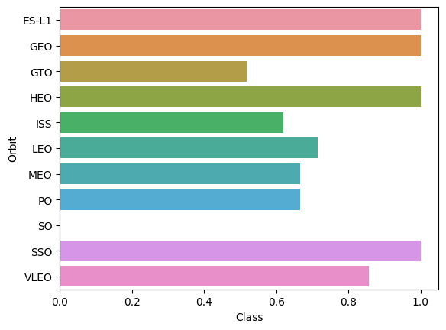
Success Rate vs. Orbit Type

Slide 20
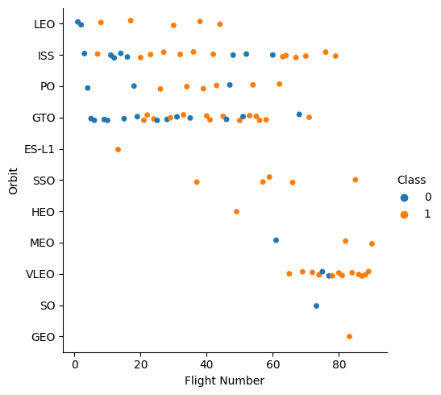
Flight Number vs. Orbit Type

Slide 21
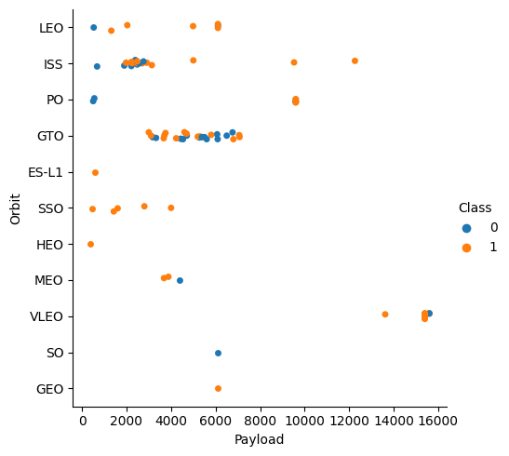
Payload vs. Orbit Type

Slide 22
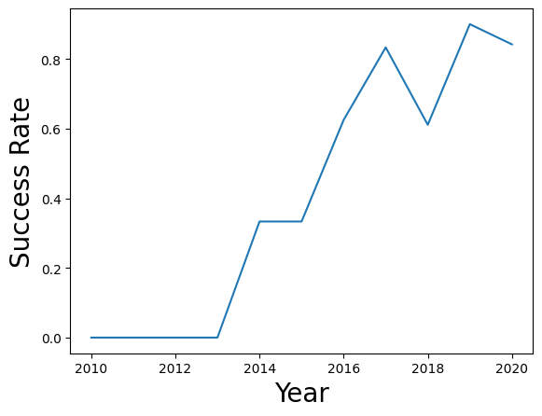
Launch Success Yearly Trend

Slide 23
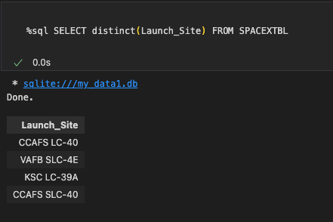
All Launch Site Names

Slide 24
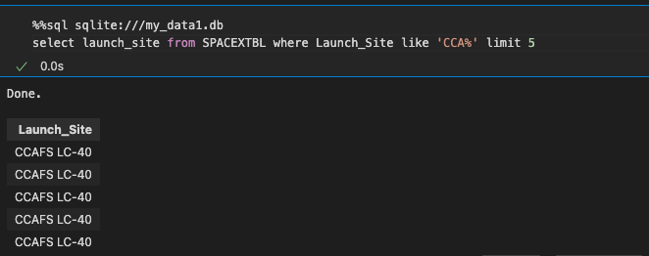
Launch Site Names Begin with 'CCA'

Slide 25
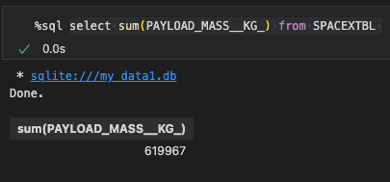
Total Payload Mass

Slide 26
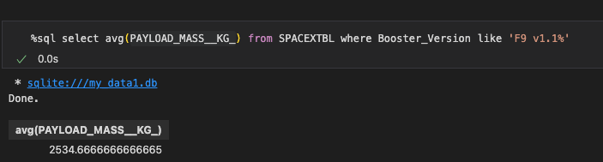
Average Payload Mass by F9 v1.1

Slide 27
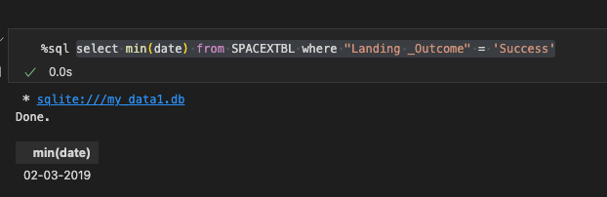
First Successful Ground Landing Date

Slide 28
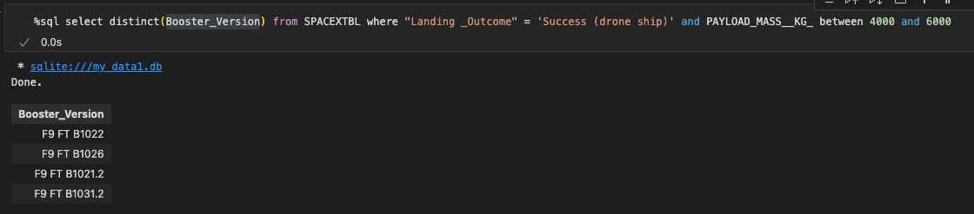
Successful Drone Ship Landing with Payload between 4000 and 6000

Slide 29
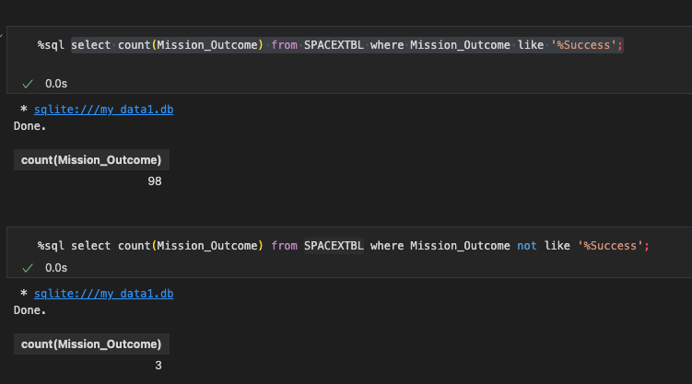
Total Number of Successful and Failure Mission Outcomes

Slide 30
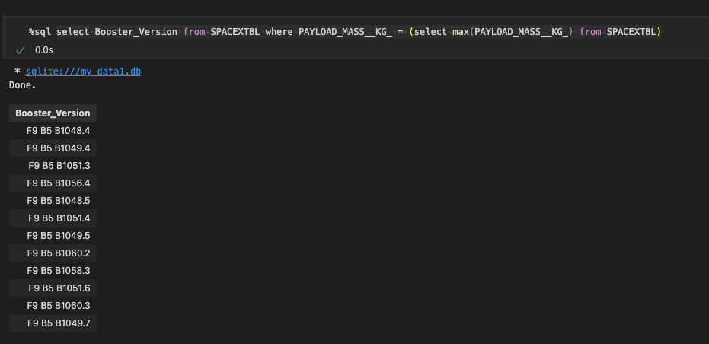
Boosters Carried Maximum Payload

Slide 31
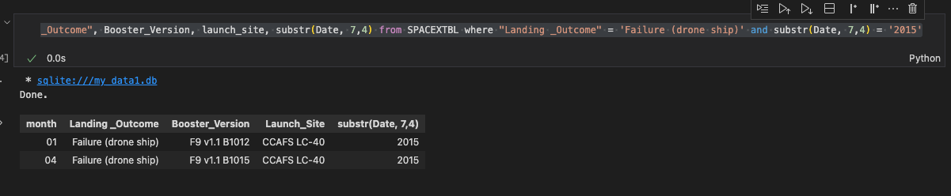
2015 Launch Records

Slide 32

Section 3

Slide 33
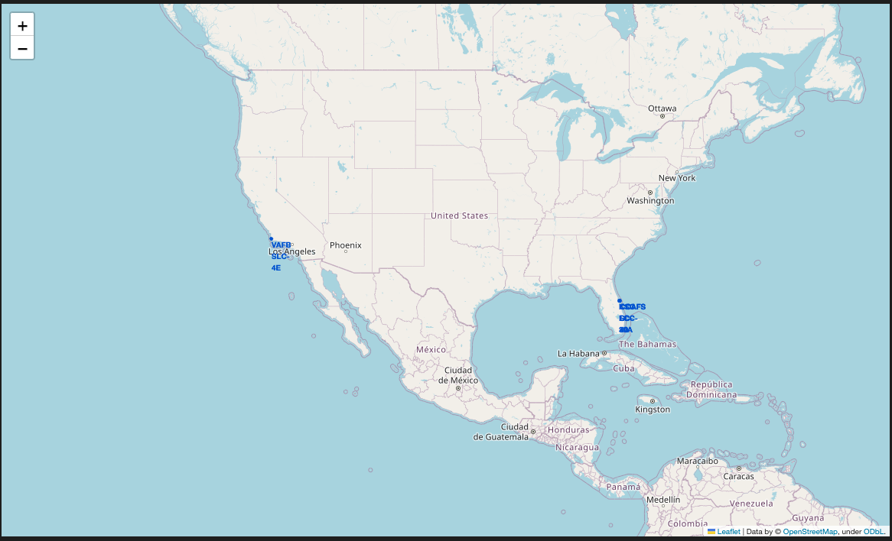
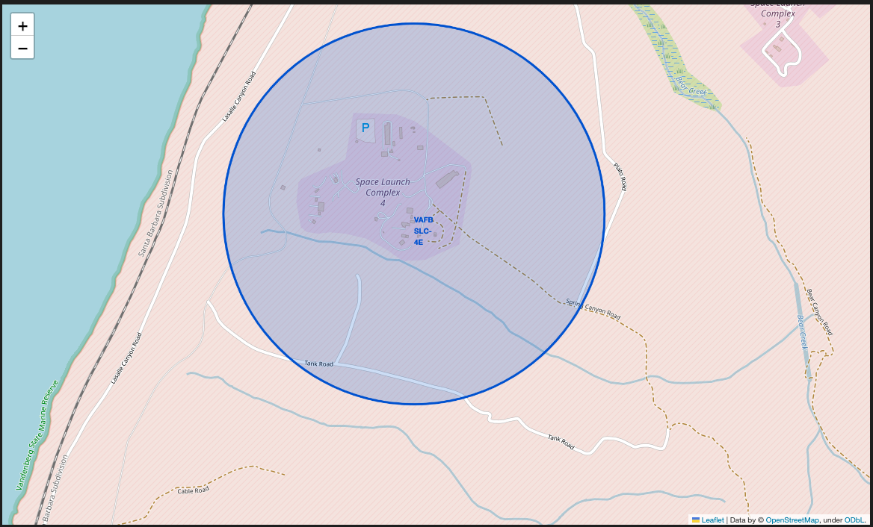
Map One – Marks and Circle

Slide 34
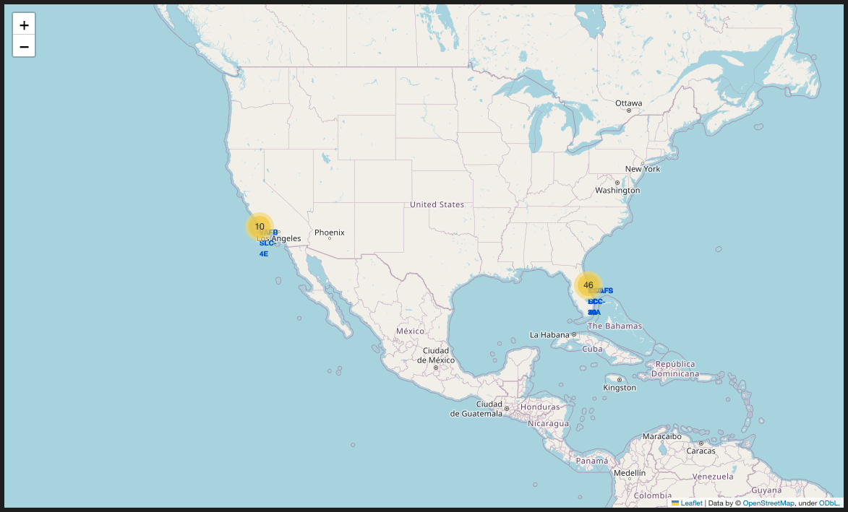
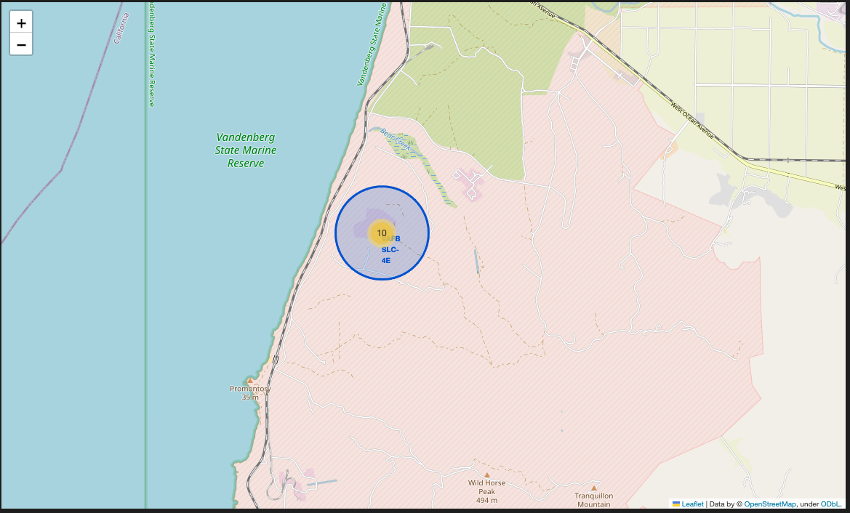
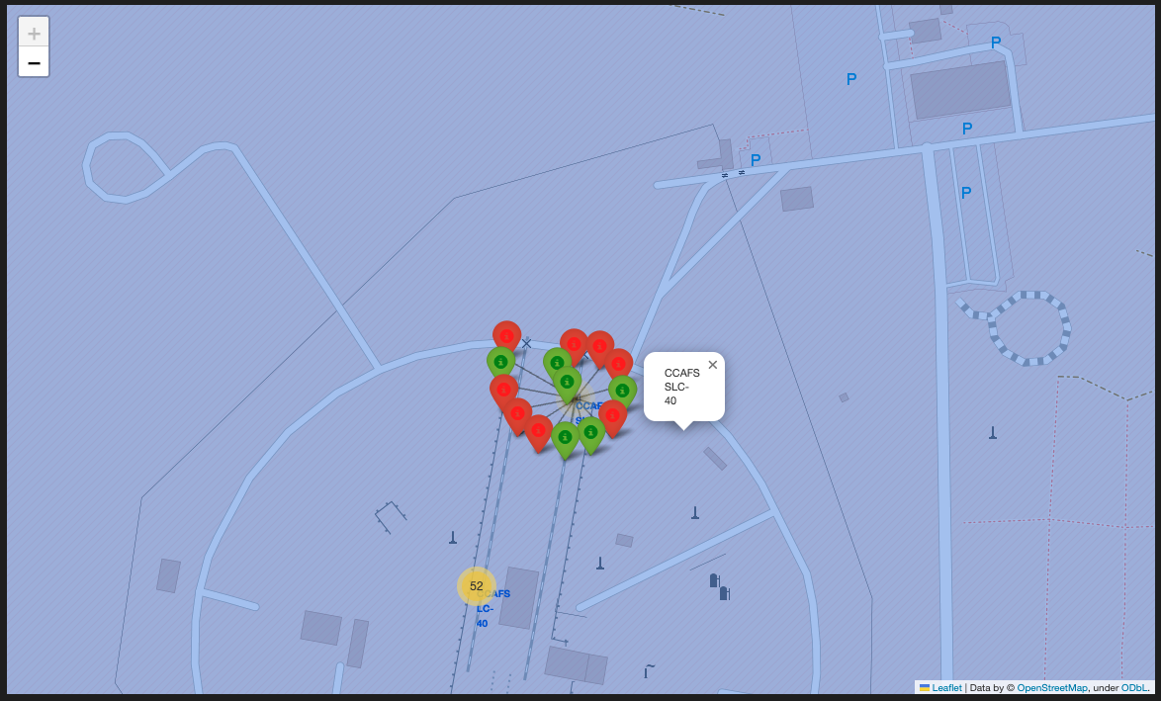
Map 2 – Cluster and Success /Failure

Slide 35
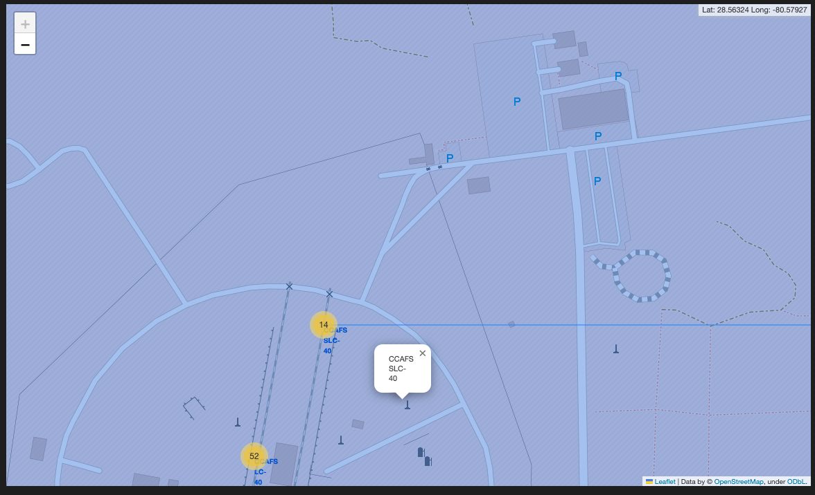
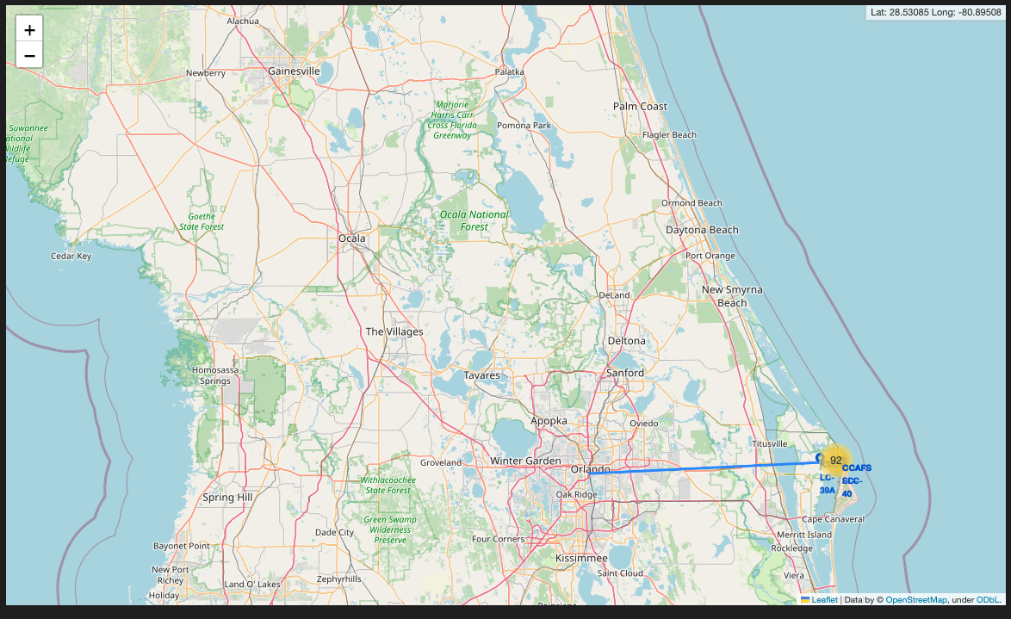
Map 3 - Line

Slide 36

Section 4

Slide 37
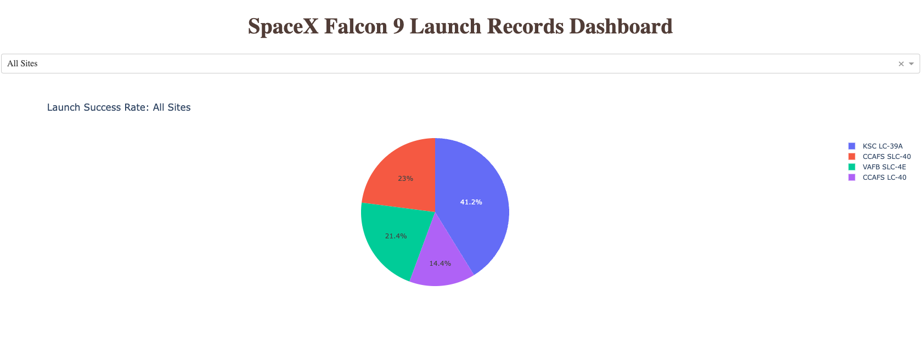
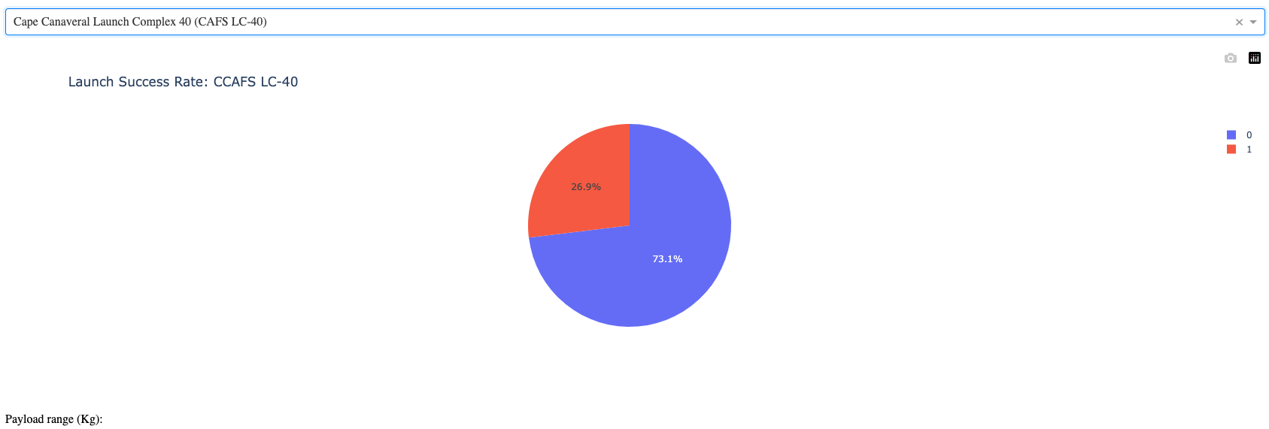
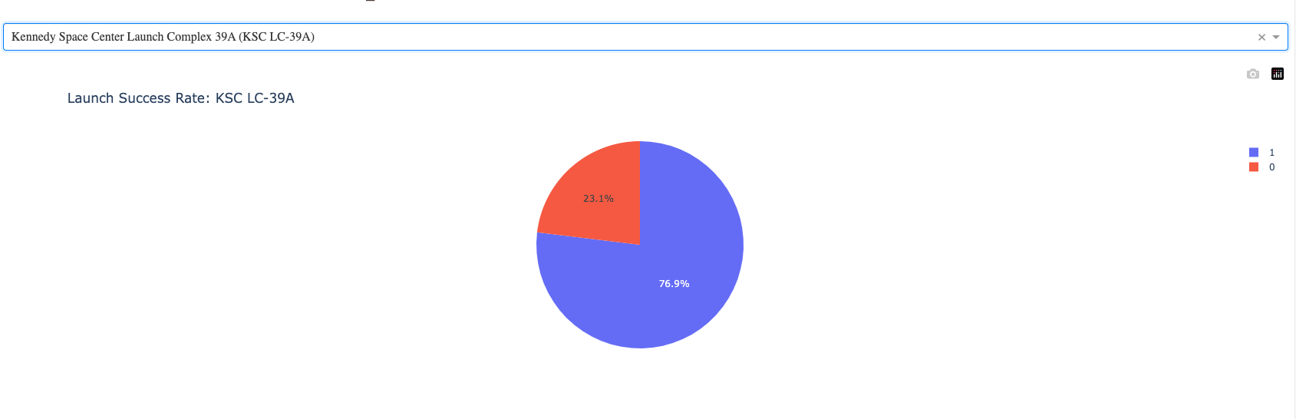
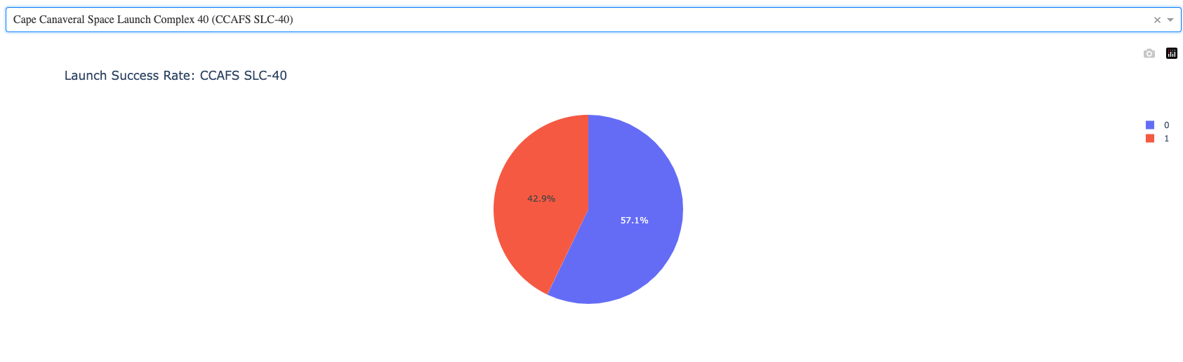
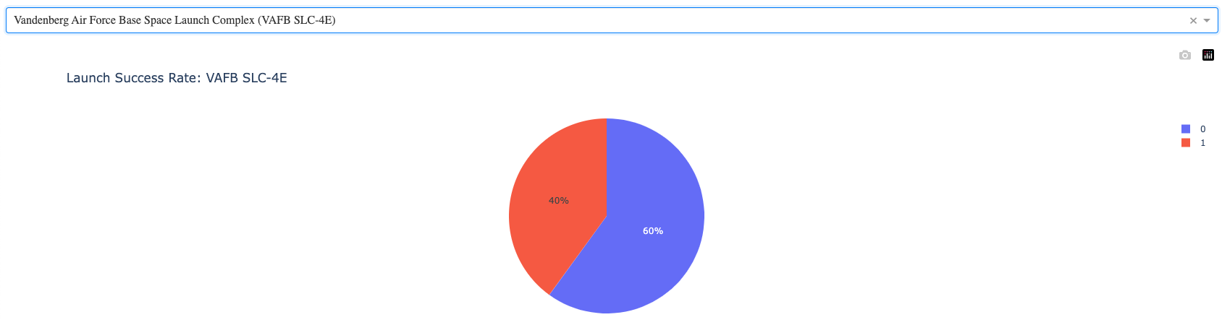
Dashbord

Slide 38
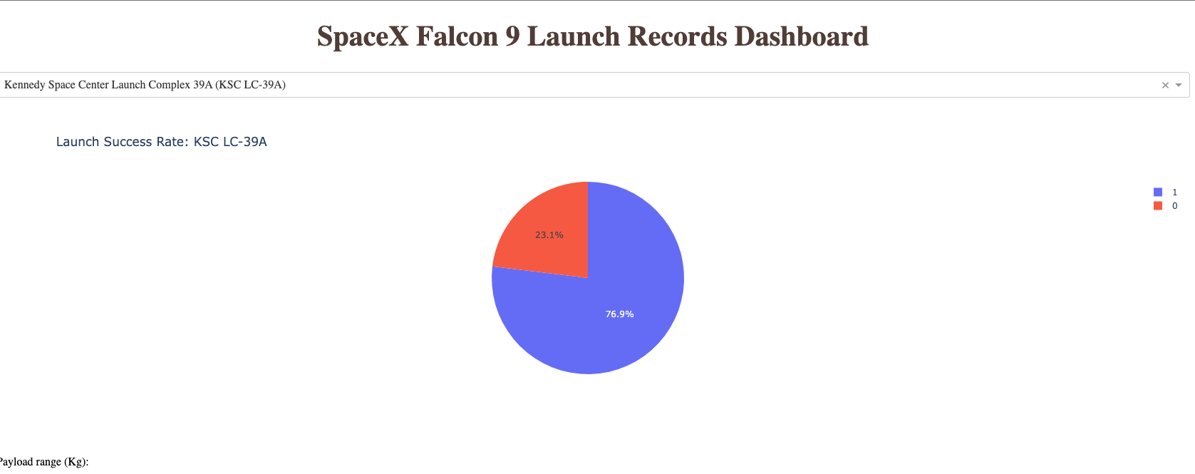
Dashboard highest success

Slide 39
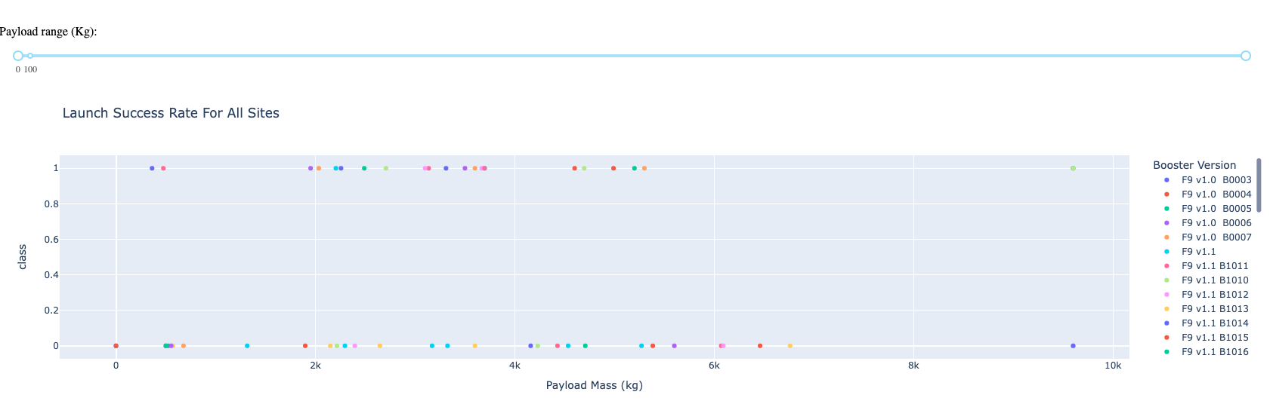
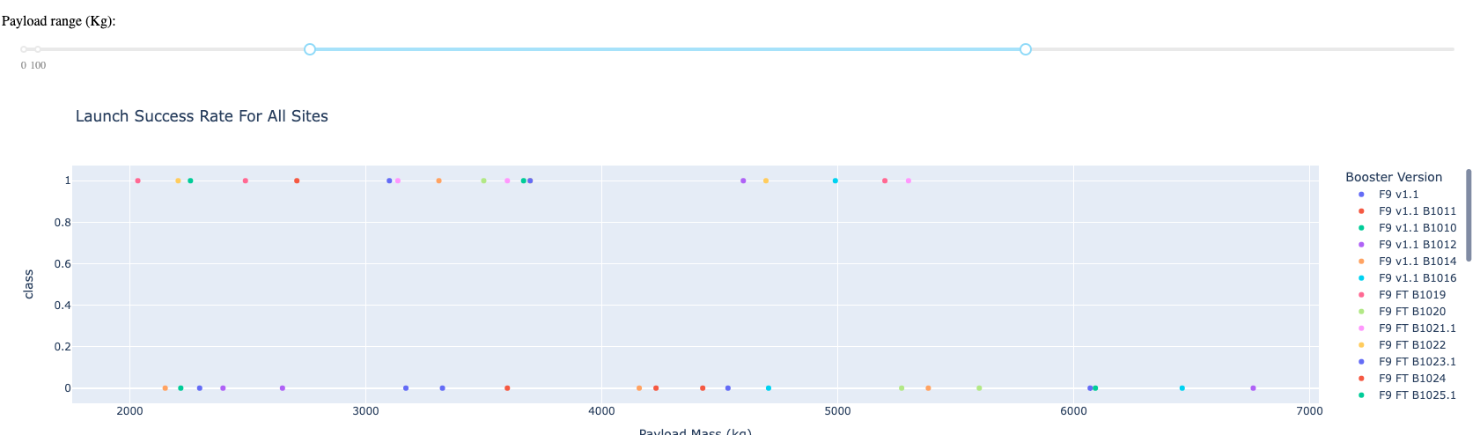
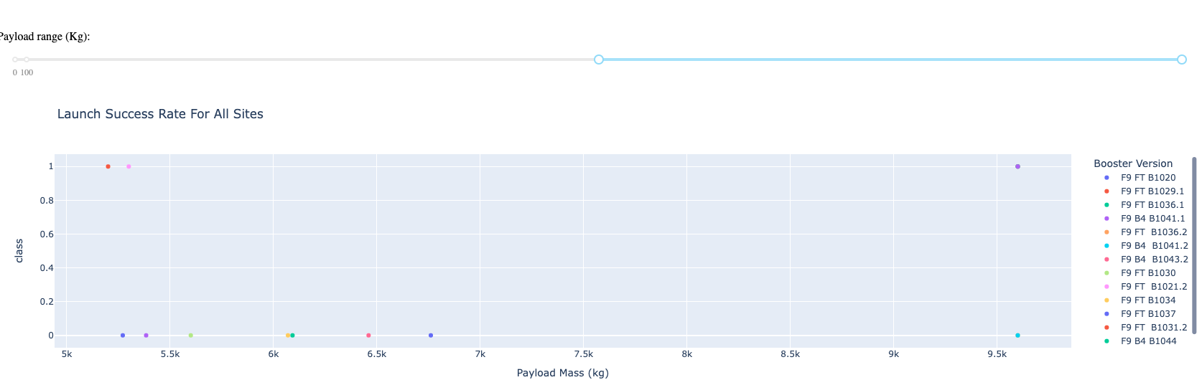
<Dashboard Screenshot 3>

Slide 40

Section 5

Slide 41
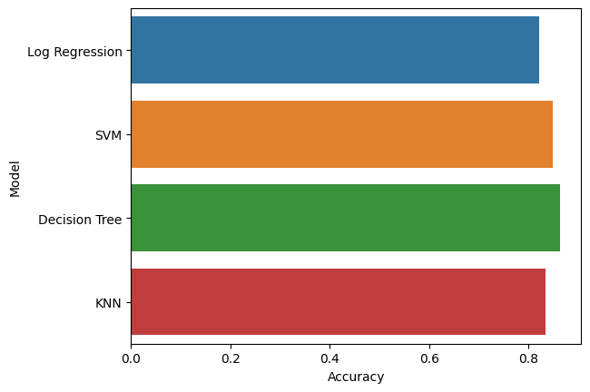
Classification Accuracy

Slide 42


Confusion Matrix
Logistic Regression
SVM
Decision Tree
KNN

Slide 43
Conclusions
Decision Tree has the best Accuracy
Comparing the R2_score in Test data, Decision tree has the best result to, with 0.94
Using the GridSearch, we could find the best hyperparameter for each model, and with the results compere each one to decide the best model

Slide 44
Appendix
Access to the github project
https://github.com/danielpedrini/capstone

Slide 45


